Slide 1
Police Homicides in the US (2015)
BIKRAMJEET S GHURA
CSE 160 AD
Notes:
HELLO
NAME
TOPIC
POLICE IN THE US HAS OFTEN BEEN ACCUSED OF BRUTAILITY AND ABUSE OF AUTHORITY. SO, I DECIDED TO ANALYZE AVAILABLE DATA AND SEE IF MY RESULTS SUPPORT THE CLAIMS MADE

Slide 2
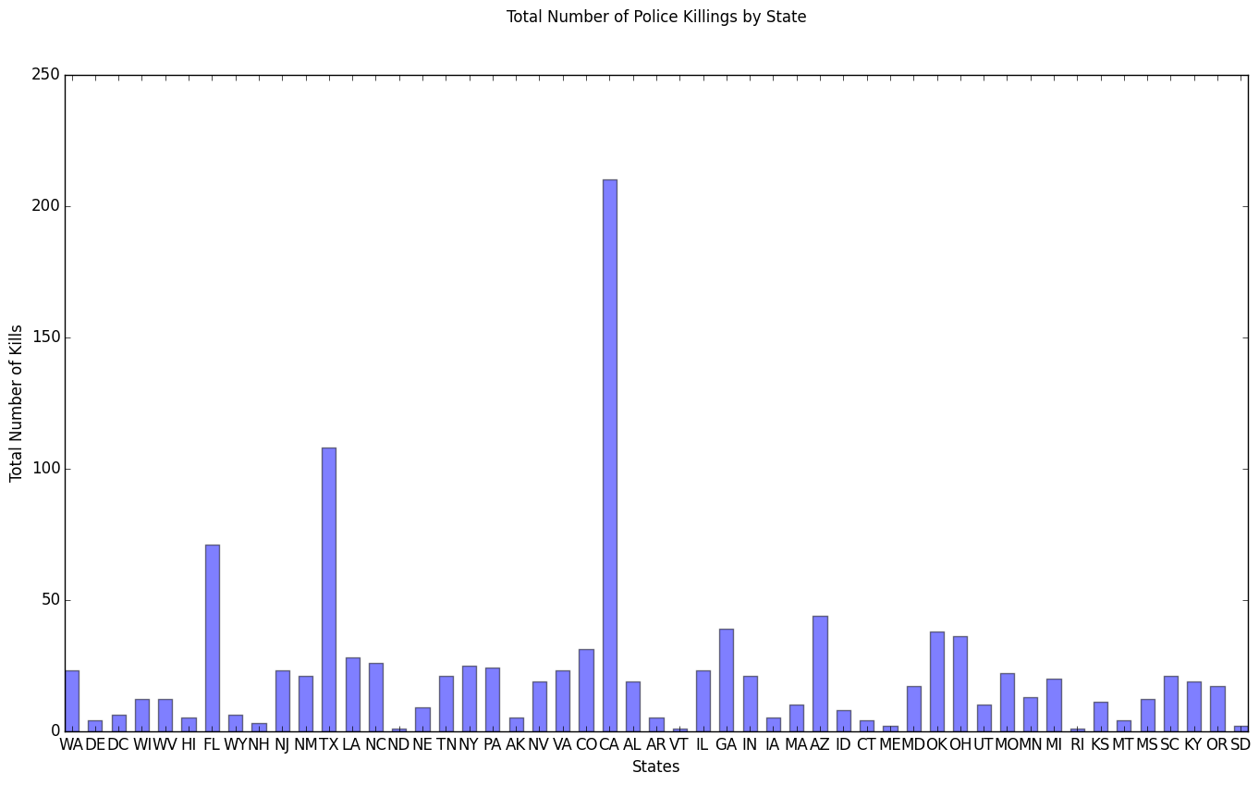
Frequency of Police Kills (by State)
Notes:
1. STATE WITH THE HIGHEST NUMBER OF KILLS
CAL

Slide 3
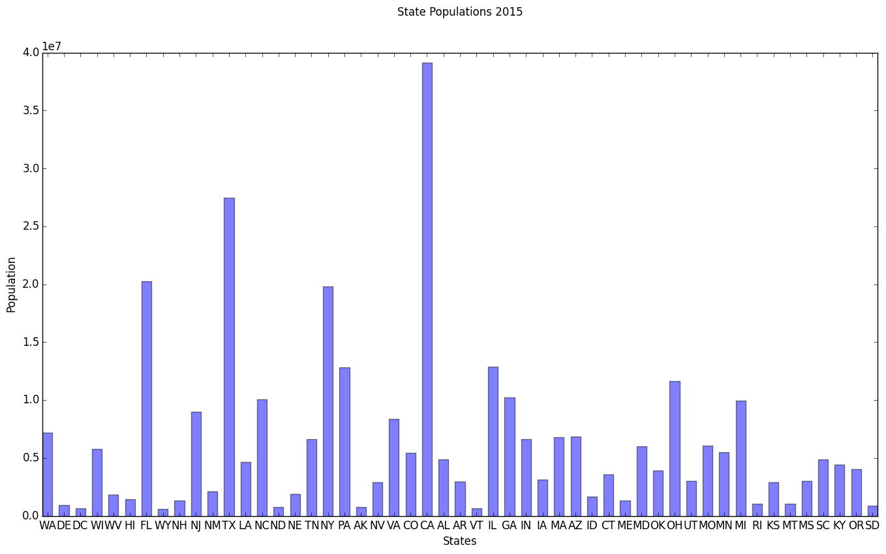
Population of each state (IN MILLIONS) - 2015
Notes:
CA AND POPULATION

Slide 4
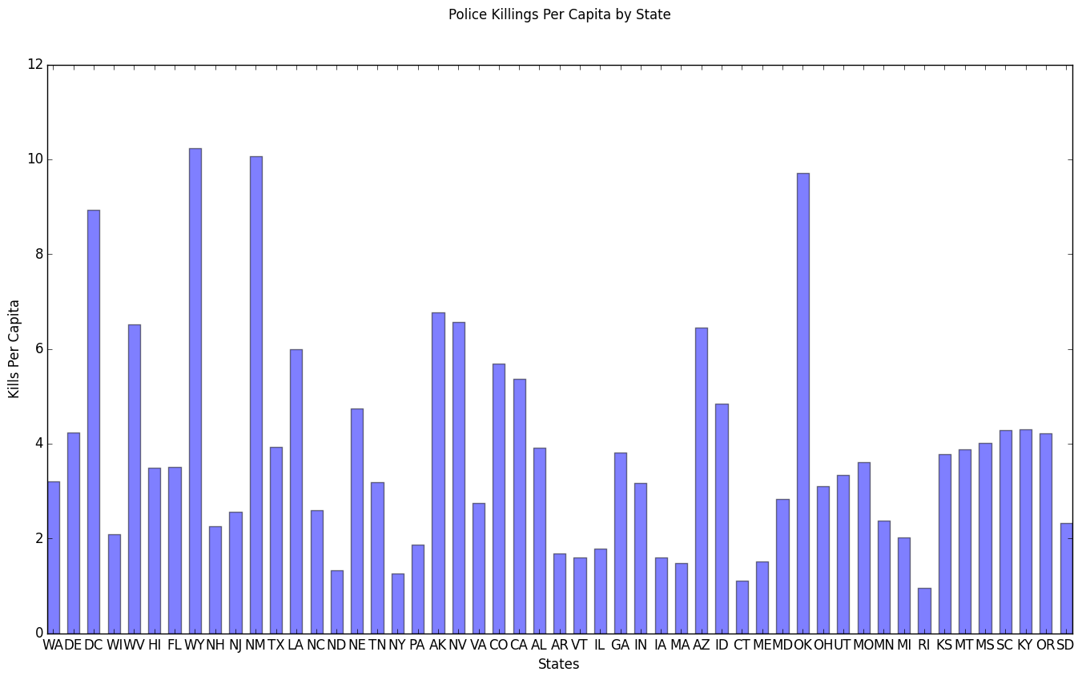
Per capita Kills (By state)
Notes:
WYOMING, NEW MEXICO OKLAHOMA

Slide 5
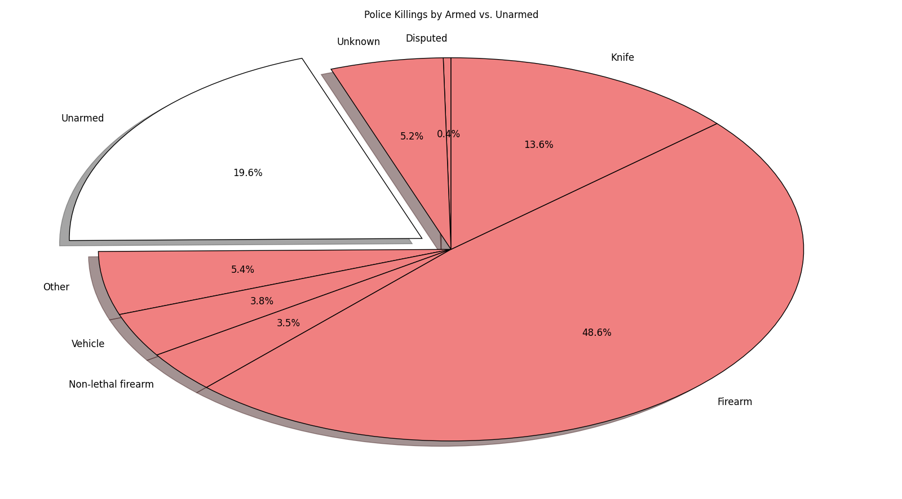
VICTIMS OF POLICE HOMICIDE: ARMED VS UNARMED
Notes:
OUT OF THE PEOPLE KILLED, PEOPLE WHO WERE ARMED WERE MORE LIKELY TO BE VICTIMS, IT CAN BE INFERRED THAT AN ARMED PERSON IS MORE

Slide 6
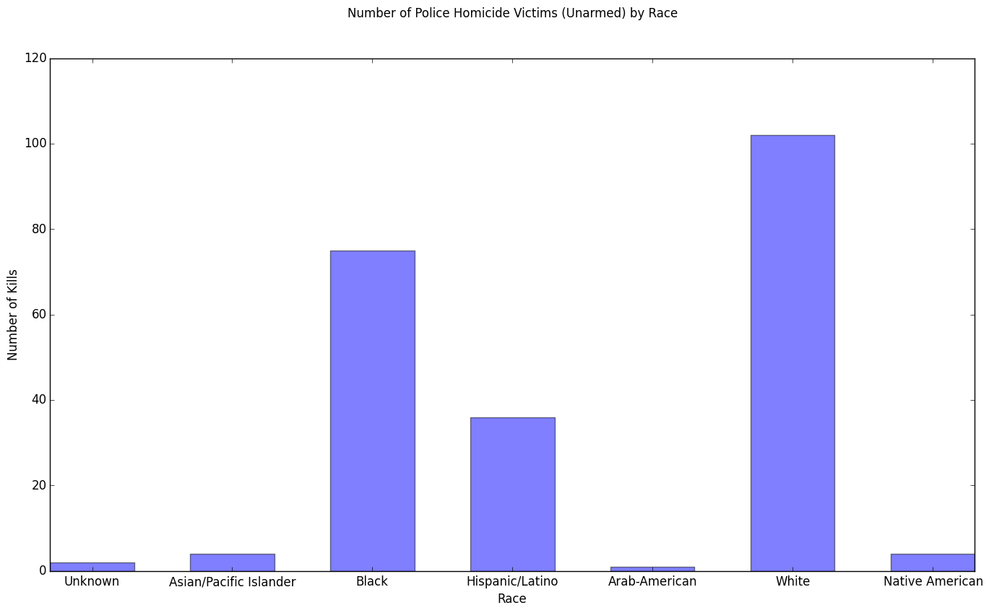
NUMBER OF UNARMED PEOPLE KILLED (BY RACE)
Notes:
BLACK, WHITE AND HISPANICS EXPERIENCED A HIGHER NUMBER OF KILLINGS
ARMED CAN BE SEEN AS A CONFOUNDING FACTOR

Slide 7
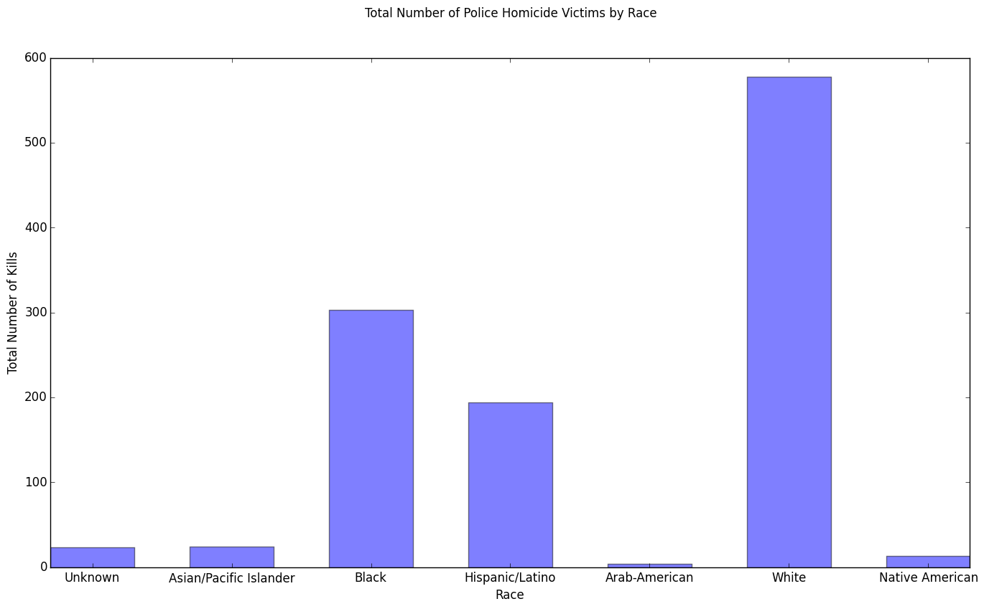
TOTAL NUMBER OF KILLS (BY RACE)
Notes:
POPULATION CAN BE A FACTOR

Slide 8
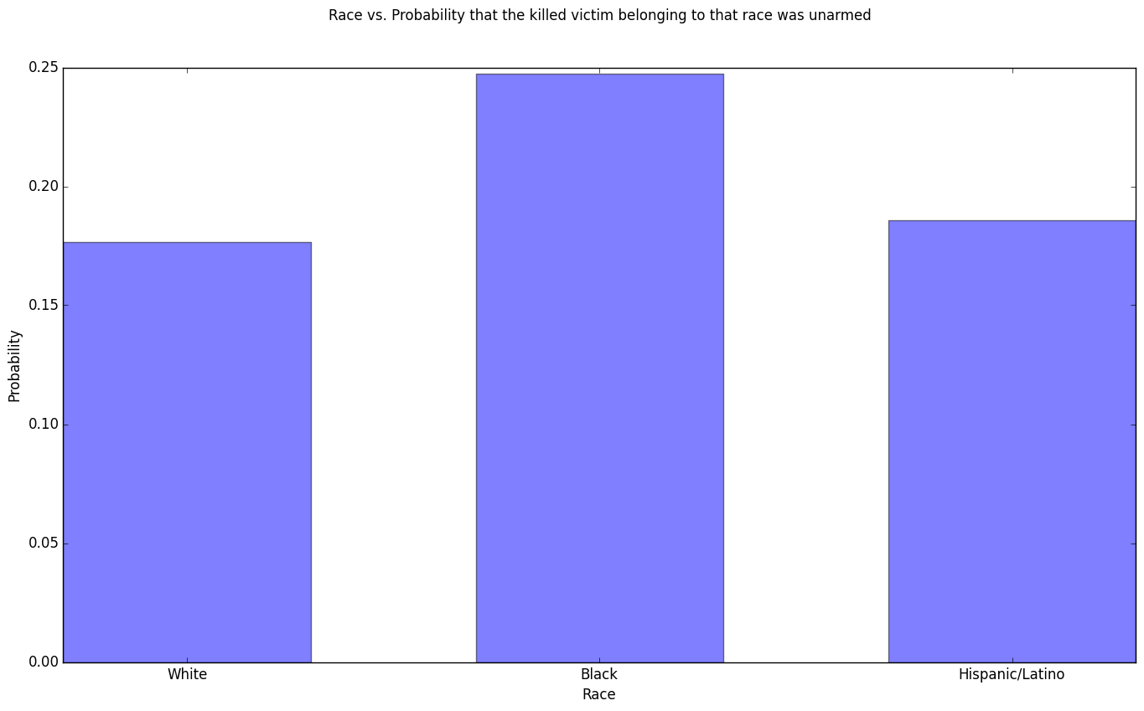
PROBABILITY OF A VICTIM BEING UNARMED (BY RACE)
Notes:
OUT OF THE TOTAL UNARMED PEOPLE KILLED, PROBABILITY OF A VICTIM BEING BLACK IS HIGHER, RACIAL BIAS INVOLVED

Slide 9
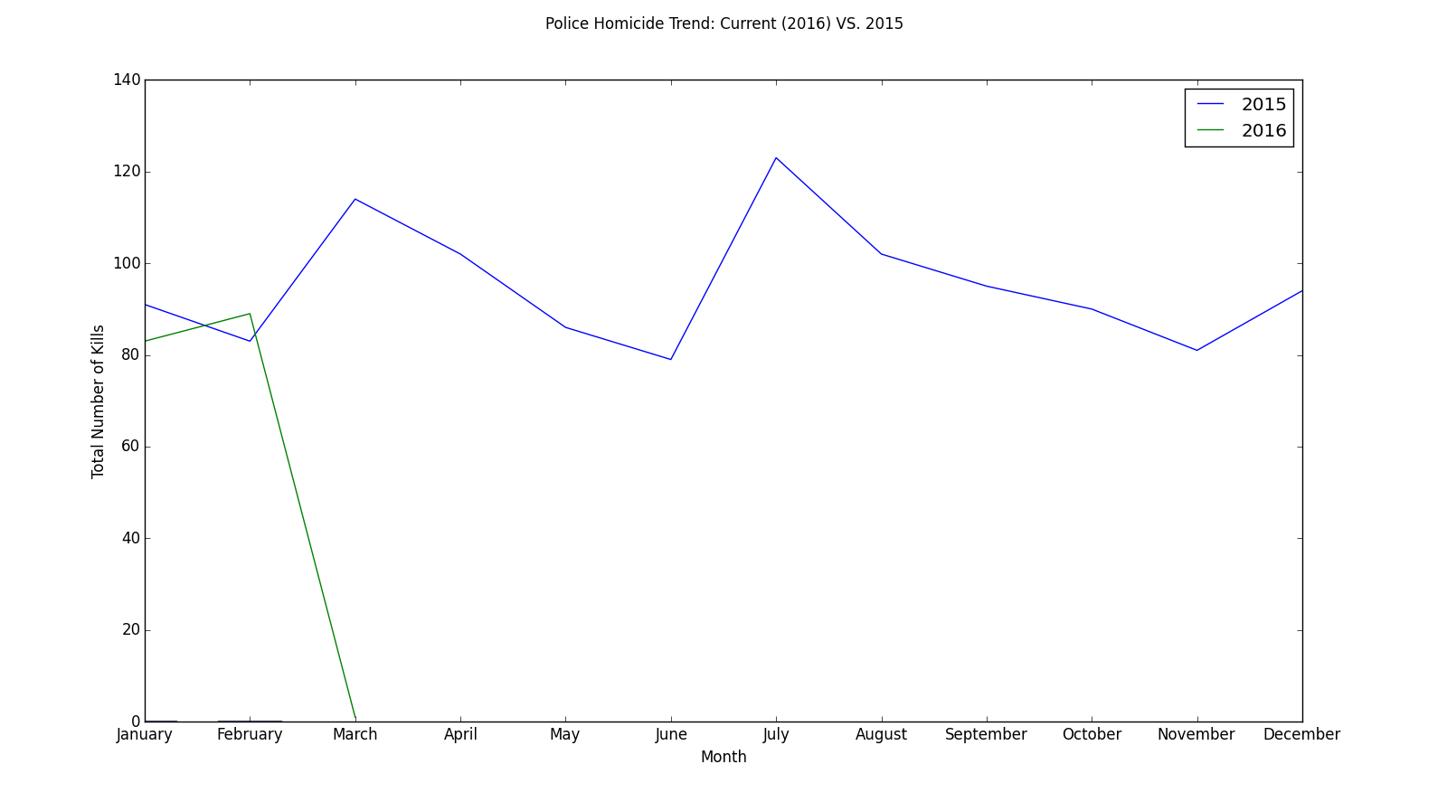
POLICE HOMICIDE TREND: CURRENT (2016) VS 2015
Notes:
SLOW DECLINE FROM LATE MARCH TO EARLY JUNE - ALSO THE TIME HIGHER PROTESTS, COMPARING THE TWO TREND FROM JAN TP MARCH, CAN BE SEEN THAT
COMPARING,

